Slide 1
Idea ID | 6067
Team Name | Team TechX
SBU Name | INS NA
Idea / Prototype Title | Predict and Prevent PET insurance claims cost through Digital (AI/ML/CV)
Team PoC | Vetrivel, Jagadeesan 116645
Team Members | Jaya Venkataraman – 137285 Balusamy, Mahendran – 246394 Bose, Geetha – 212996 Ramesh, Shreenidhi - 858806

Slide 2

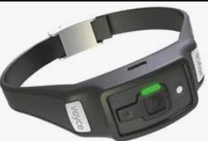


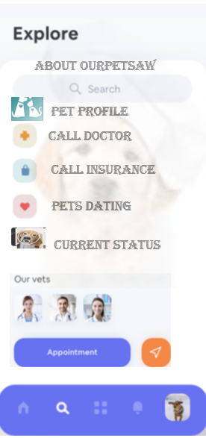

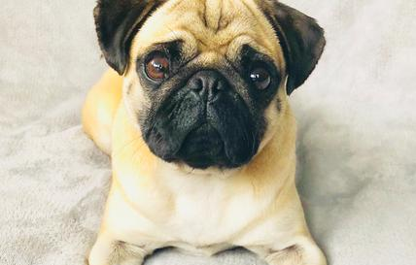
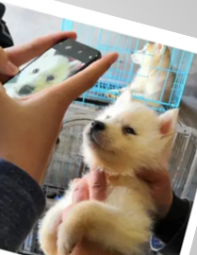
Predict and Prevent PET insurance claims cost through Digital – Improving PET’s health with Vision
BUSINESS SCENARIO
Visual representation of idea / Wireframe
UNIQUENESS / INNOVATIVENESS
Day by Day we see more adaptions and hence Increase in PET claims cost. The cost of the average pet insurance premium has gone up by 50% in the last ten years, but the average claim has gone up by 75%. It is estimated that in 2020, over $30 billion spent on vet care and product sales.
The 50% increase over the last decade is due to a variety of factors but it is likely that the main reason has been higher vet fees. When vet fees increase, insurers have to pay out more when a customer makes a claim. Premiums have been increasing in order to cover the higher payouts. Also getting good coverage of best insurance is a greatest challenge.
PET insurance IT and business stakeholders are slightly impacted.
Pet bot connects insurers, insured and Vets
No such solution exists today is an biggest advantage.
This is a startup opportunity and also First in the InsureTech segment
Our Extra don't cost Extra is the slogan
Introducing OurPetSaw systems
INNOVATION OPPORTUNITY
SOLUTION DESCRIPTION
BENEFITS
Provide peace of mind at home and improved outcomes for PET’s health.
PET care deserves Digital innovation(AI, IoT, Cloud) to improve health and optimize Claims cost. Insurance companies offer wellness package (yearly health check) but this is not adequate.
Continuous monitoring of PET health will help predict illness and prevent illness rather than find and treat illness. ~10 to 40% insurance cost shall be optimized through continuous health monitoring solution.
As this is going to predict the illness upfront which will also benefit the Pet’s life to an extend.
Deliver actionable, health insights for proactive care.
PET recognition based solution will monitor PET health equipped with the Internet of things and AI/ML technology .
It constantly monitors Pets health and identify signs of illness upfront and alert the owner and nearby Vets for emergency.
Face Recognition, body temperature and other data related to health can be data streamed and diagnosed as needed.
Technologies such as AWS Deeplense, AWS Sagemaker, Angular, Python, Lambda, AWS Recognition, S3, SNS are recommended.
Assuming the availability of Hardware and software to test the solution.
Showcase to PET insurance customers this can be brought into production world.
Yes, there will be revenue increase
Yes, there will be cost reduction for customer/cognizant based on solution.
10 to 40% insurance cost can be optimized based on this solution.

Slide 3
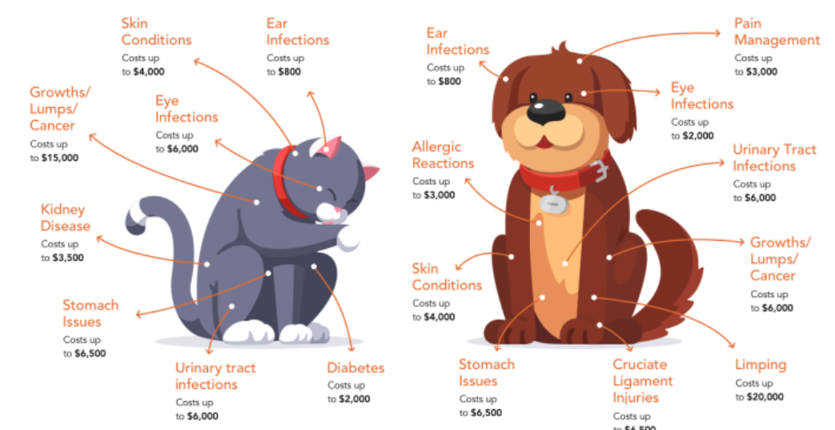



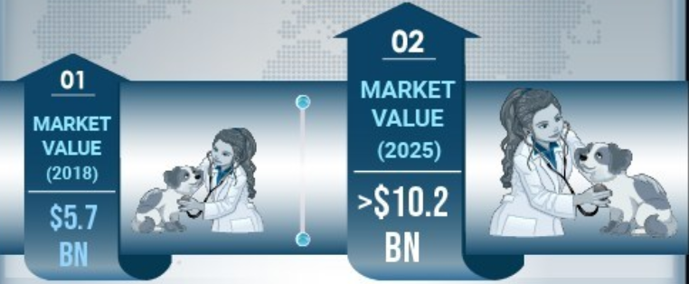
Pet Current Market
With increasing healthcare cost for pets, the owners are readily adopting pet health insurance, boosting the market growth.
Growth Drivers
Key Anticipation for Loss or Increase in premium
Increasing number of pet adoption
Increasing awareness about pet insurance policies in North America
Rising veterinary service cost
Companies offering innovative pet insurance coverage
Sudden Illness without Diagnosis
Insufficient Hereditary Information
High Veterinary Charge
Vital signs | Dogs | Minimum - Maximum
Respiration | Small dogs | 20 - 40 breaths per minute
 | Larger dogs | 10 to 30 breaths per minute
Temparature | All | 100 and 102.5 degrees Farenheit
Pulse | Small dogs | 90 and 160 beats per minute
 | Larger dogs | 65 and 90 beats per minute
Hydration | All | 70% of body weight
Vital signs | Cats | Minimum - Maximum
Respiration rate | All | 35 - 40 breaths per minute
Temparature | All | 99.9 or above 102.5 degreee farenheit
Pulse | All | 140 and 220 beats per minute
Unexpected Injury
Current Facts
On an Average the cost of a single surgical vet visit is estimated to be $~426 for a dog and $~214 for a cat.(The geographic location of the veterinary clinic matters too)
Keep in mind that even some of the more common issues, such as treating parvo in puppies, can be quite expensive — the average claim is over $900. And serious afflictions like cancer are rarer, but treatment is also much more costly — chemotherapy alone can cost $5,000 to $10,000.
Pet Owners will probably incur at least one $2000 to $4000 bill for emergency pet care at some point during pets lifetime.
Added benefits like 80-90% coverage on treatment costs could boost the demand for pet insurance policies, stimulating market growth.

Slide 4





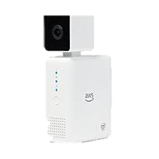







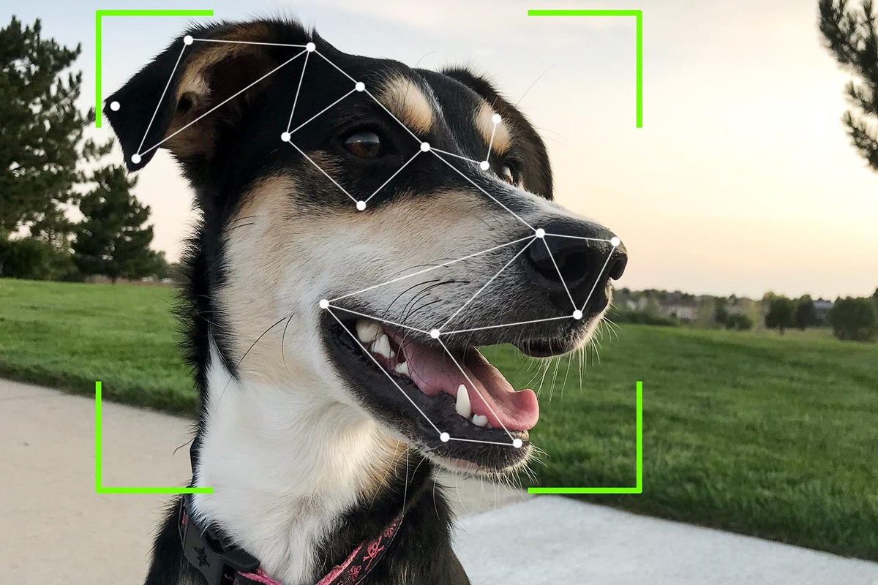



Proposed OurPetSaw solution architecture (1/2)
OurPetSaw Systems
AWS
Cloud
7
Process Monitoring & Management
1
CloudWatch
CloudTrail
Dashboard
8
2
Raw/Curated Data
AWS Kafka
Kinesis
3
4
6
Stream Producer
API Persist data
and streams
S3
Video Stream
Analysis
Data
Simple Notification system
Glue Jobs
AWS Glue
(snap) File Drop
5
Fit Bit Monitor
Queue
Processor
S3 - Drop Zone
For every record
API Call
Pet Rekognition
API Writes to Queue
Lamda
API Gateway

Slide 5
Appendix

Slide 6
Pet Insurance current Market
What Is Pet Insurance?
Pet insurance typically provides coverage for the cost of care resulting from accidental injuries or unexpected illnesses for dogs, cats, and other household pets. Such incidents commonly include trauma from car accidents, cancer treatment, ingested poisons or objects, and degenerative conditions.
Pet insurance is not standardized. Currently, lawmakers are working on establishing appropriate regulatory standards for the pet insurance industry.¹¹﻿ Once you decide that you are interested in pet insurance, review what is included (or excluded) when you are making your policy selection, and see how the features protect your needs.
It is estimated that in 2020, over $30 billion will be spent on vet care and product sales.¹²﻿ Pet insurance typically includes coverage for accidental injuries, unexpected illnesses (without previous history), and the associated tests or treatments required to heal your pet.¹³﻿
Coverage often includes:
Emergency room visits
X-rays, MRIs, and other diagnostic tests
Emergency surgeries
Cancer treatments
Some pet insurance plans provide access to vet consultations over the phone or via apps. These services may help save you money when you are unsure if something is a medical emergency or not.

Slide 7
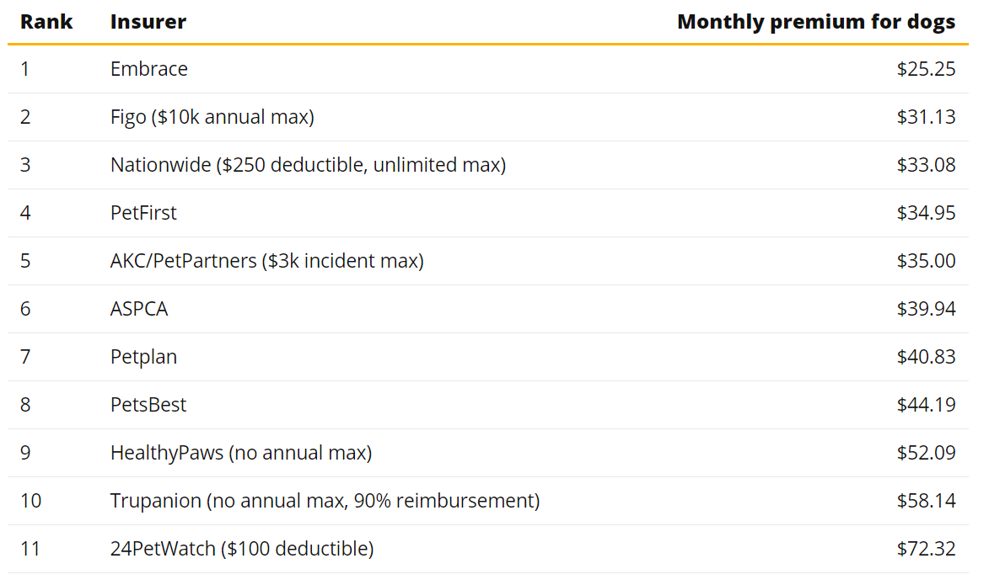
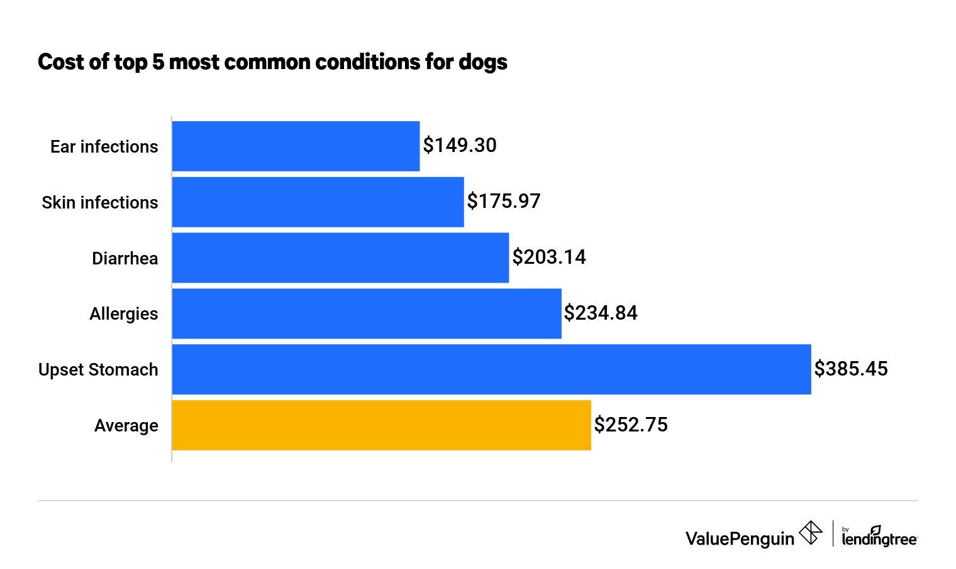
According to data based on average claims from PetFirst holders, the most common dog treatments cost $252.75 on average, while the most common cat treatments cost $266.79.
Keep in mind that even some of the more common issues, such as treating parvo in puppies, can be quite expensive — the average claim is over $900. And serious afflictions like cancer are rarer, but treatment is also much more costly — chemotherapy alone can cost $5,000 to $10,000.

